Slide 1
Main macroeconomic indicators for EU
Assistant Professor Pawel Dobrzanski Wroclaw University of Economics

Slide 2
EU-28 and G20 countries
Source: The UE in the World. Eurostat, Publications Office of the European Union, 2016

Slide 3
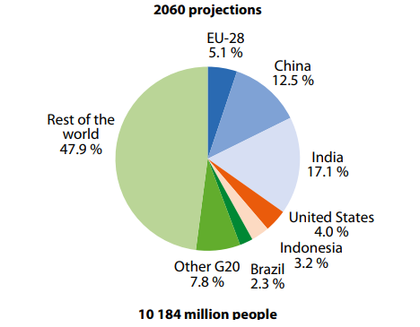
Population
Source: The UE in the World. Eurostat, Publications Office of the European Union, 2016

Slide 4
Life expectancy at birth by sex, 2013(years)
Source: The UE in the World. Eurostat, Publications Office of the European Union, 2016

Slide 5
Old-age dependency ratio, 1960, 2014 and 2060 (population aged 65 or more as a percentage of the population aged 15–64)
Source: The UE in the World. Eurostat, Publications Office of the European Union, 2016

Slide 6
Public expenditure on social protection benefits, 2003 and 2013 (% of GDP)
Source: The UE in the World. Eurostat, Publications Office of the European Union, 2016

Slide 7
Gross household adjusted disposable income per inhabitant, 2014(international USD)
Source: The UE in the World. Eurostat, Publications Office of the European Union, 2016

Slide 8
Household consumption expenditure by type of expenditure, 2014 (% of total household consumption expenditure)
Source: The UE in the World. Eurostat, Publications Office of the European Union, 2016

Slide 9
Distribution of income by quantiles, 2013(%)
Source: The UE in the World. Eurostat, Publications Office of the European Union, 2016

Slide 10
Public expenditure on education, 2002 and 2012(% of GDP)
Source: The UE in the World. Eurostat, Publications Office of the European Union, 2016

Slide 11
Tertiary educational attainment by sex, 2014 (% of total population aged 25 and over having completed tertiary education)
Source: The UE in the World. Eurostat, Publications Office of the European Union, 2016

Slide 12
Unemployment rate, persons aged 15–64, 2009 and 2014(%)
Source: The UE in the World. Eurostat, Publications Office of the European Union, 2016

Slide 13
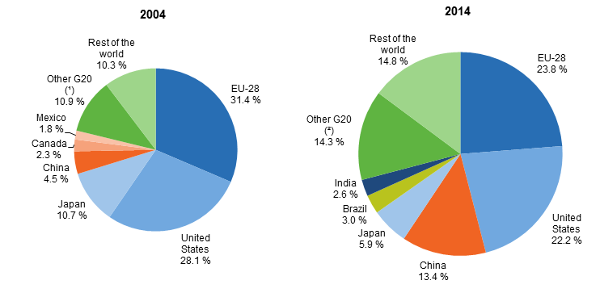
Share of world GDP, 2004 and 2014
Source: https://europa.eu/european-union/about-eu/figures/economy_en#tab-0-1

Slide 14
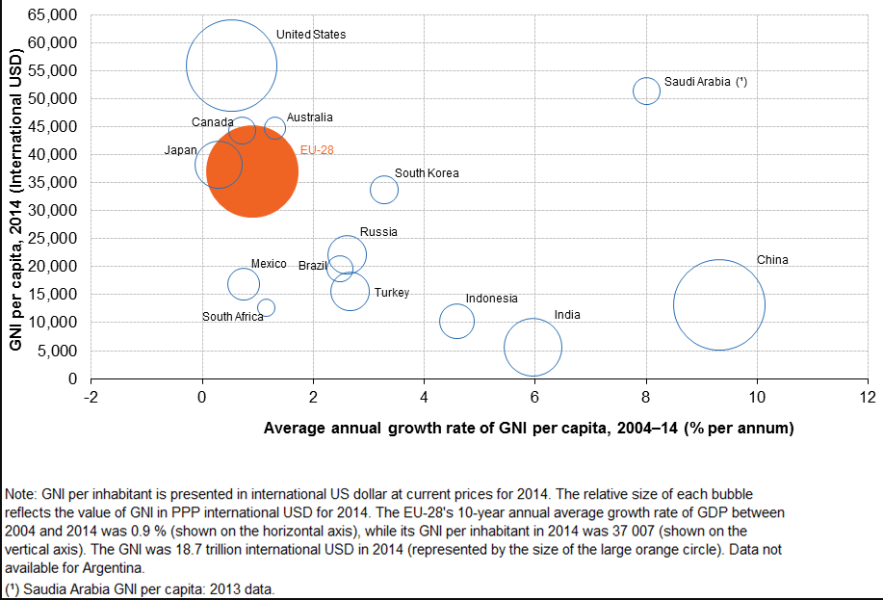
GNI per inhabitant and average annual growth of GNI per capita V2
http://ec.europa.eu/eurostat/statistics-explained/index.php/File:GNI_per_inhabitant_and_average_annual_growth_of_GNI_per_capita_V2.png

Slide 15
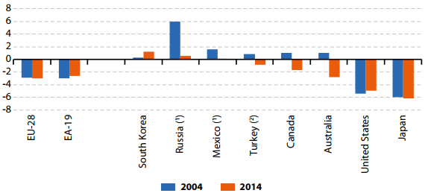
General government deficit / surplus, 2004 and 2014 (% of GDP)
Source: The UE in the World. Eurostat, Publications Office of the European Union, 2016

Slide 16
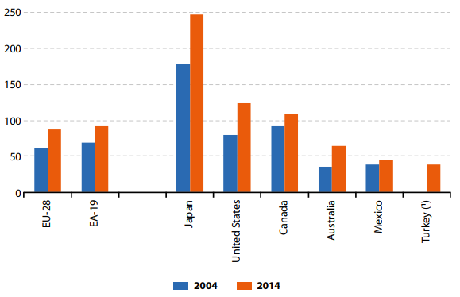
General government debt, 2004 and 2014 (% of GDP)
Source: The UE in the World. Eurostat, Publications Office of the European Union, 2016

Slide 17
Flows of foreign direct investment, 2014 (% of GDP)
Source: The UE in the World. Eurostat, Publications Office of the European Union, 2016

Slide 18
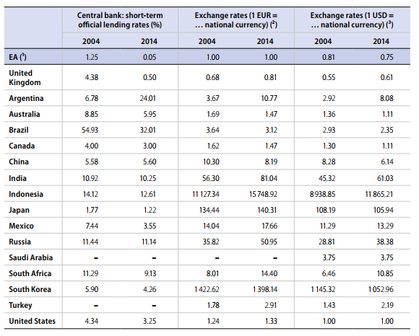
Interest and exchange rates, 2004 and 2014
Source: The UE in the World. Eurostat, Publications Office of the European Union, 2016

Slide 19
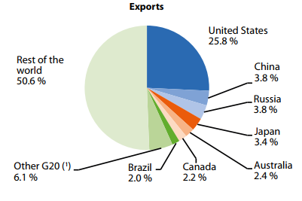
EU-28 International exports and imports of services by main partners, 2014 (% share of extra-EU-28 exports and imports)
Source: The UE in the World. Eurostat, Publications Office of the European Union, 2016

Slide 20
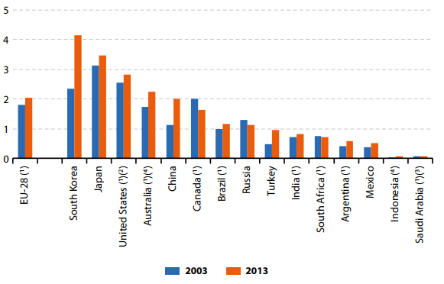
Gross domestic expenditure on research and development relative to GDP, 2003 and 2013 (% of GDP)
Source: The UE in the World. Eurostat, Publications Office of the European Union, 2016

Slide 21
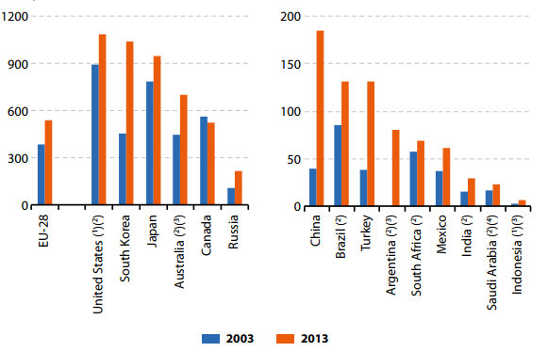
Gross domestic expenditure on research and development per inhabitant, 2003 and 2013 (EUR per inhabitant)
Source: The UE in the World. Eurostat, Publications Office of the European Union, 2016

Slide 22
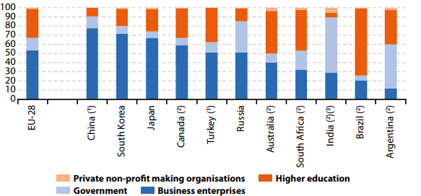
Research and development personnel, by employer, 2013 (%, based on full-time equivalents)
Source: The UE in the World. Eurostat, Publications Office of the European Union, 2016

Slide 23
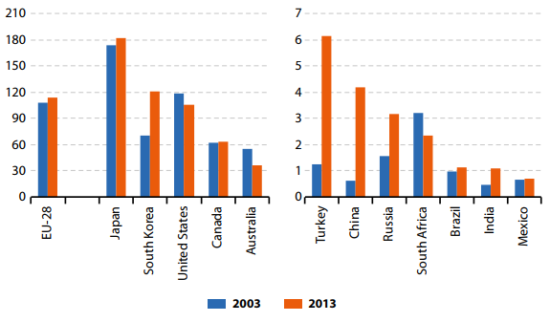
Patent applications to the European patent office, 2003 and 2013 (per million inhabitants)
Source: The UE in the World. Eurostat, Publications Office of the European Union, 2016

Slide 24
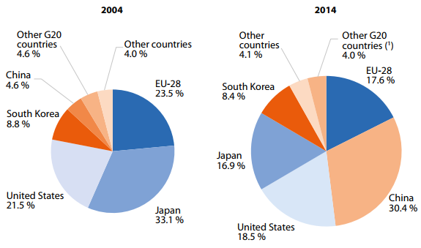
Share of world patent applications, 2004 and 2014 (%)
Source: The UE in the World. Eurostat, Publications Office of the European Union, 2016

Slide 25
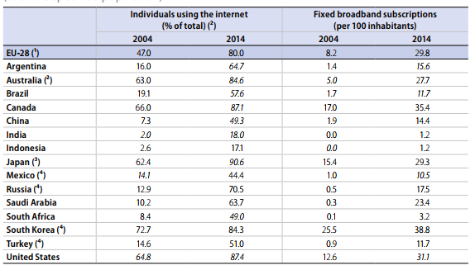
ICT access and usage by individuals aged 15–74, 2004 and 2014 (% of the specified population)
Source: The UE in the World. Eurostat, Publications Office of the European Union, 2016

Slide 26
Important questions
What are the biggest challenges for the European Union?
What are the strengths of the European Union?

Slide 27
Thank you
pawel.dobrzanski@ue.wroc.pl

